Slide 1
OO Programming

Slide 2
Class
Defines methods and attributes that capture the common behaviours and characteristics of objects
It is the blue-print that explains how to construct an object

Slide 3
Object
Objects are based on a class – a specific instance of a class
Use a constructor to create an object with its own values (specific values)

Slide 4
What is instantiation
Creating a specific object from a class

Slide 5
What is meant by encapsulation?
Joining together of code (methods) and data/properties into objects.
Pre-defined methods are written to access and change data values (accessor and mutator methods)
Combining a record with the procedures and functions that manipulate it to form a new Data Type (a class)

Slide 6
What is meant by inheritance?
A class shares properties and methods with the class it is derived from (from its parent class);
Building a hierarchy of classes with each child class inheriting access to its parent class’s methods and properties

Slide 7
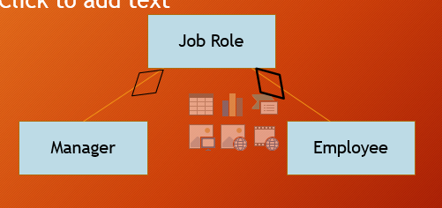
Association Aggregation
Creating an object that contains other objects, which can continue to exist even if the containing object is destroyed.

Slide 8
Composition Aggregation
Creating an object that contains other objects, and will cease to exist if the containing object is destroyed.

Slide 9
What is meant by polymorphism?
Giving an action one name that is shared up and down the class hierarchy. Each class in the hierarchy implements the action in a way appropriate to itself.
Methods can be defined with the same name in different classes but have different functions (different code)

Slide 10
Explain what is meant by overriding when writing programs that involve inheritance
Methods can be defined with the same name but have different implementation code (perform different functions)
The redefined method will be used instead of the parent’s method

Slide 11
List two features of an object
Contains its own data/fields
Contains its own operations/methods/functions/procedures
Responds to messages

Slide 12
State two advantages of the object-oriented approach to program design over the structured approach
Produces re-useable code because of inheritance/encapsulation
Produces re-useable objects
Data is protected
Data is only accessible in well defined way (because of encapsulation)
Code produced in more reliable (contains fewer errors)
Solutions are easier to understand
Easier to debug
New functions can be added to objects easily (because of inheritance)
More efficient to write programs which use pre-defined classes
Less maintenance effort required by developer since objects can be re-used

